Slide 1



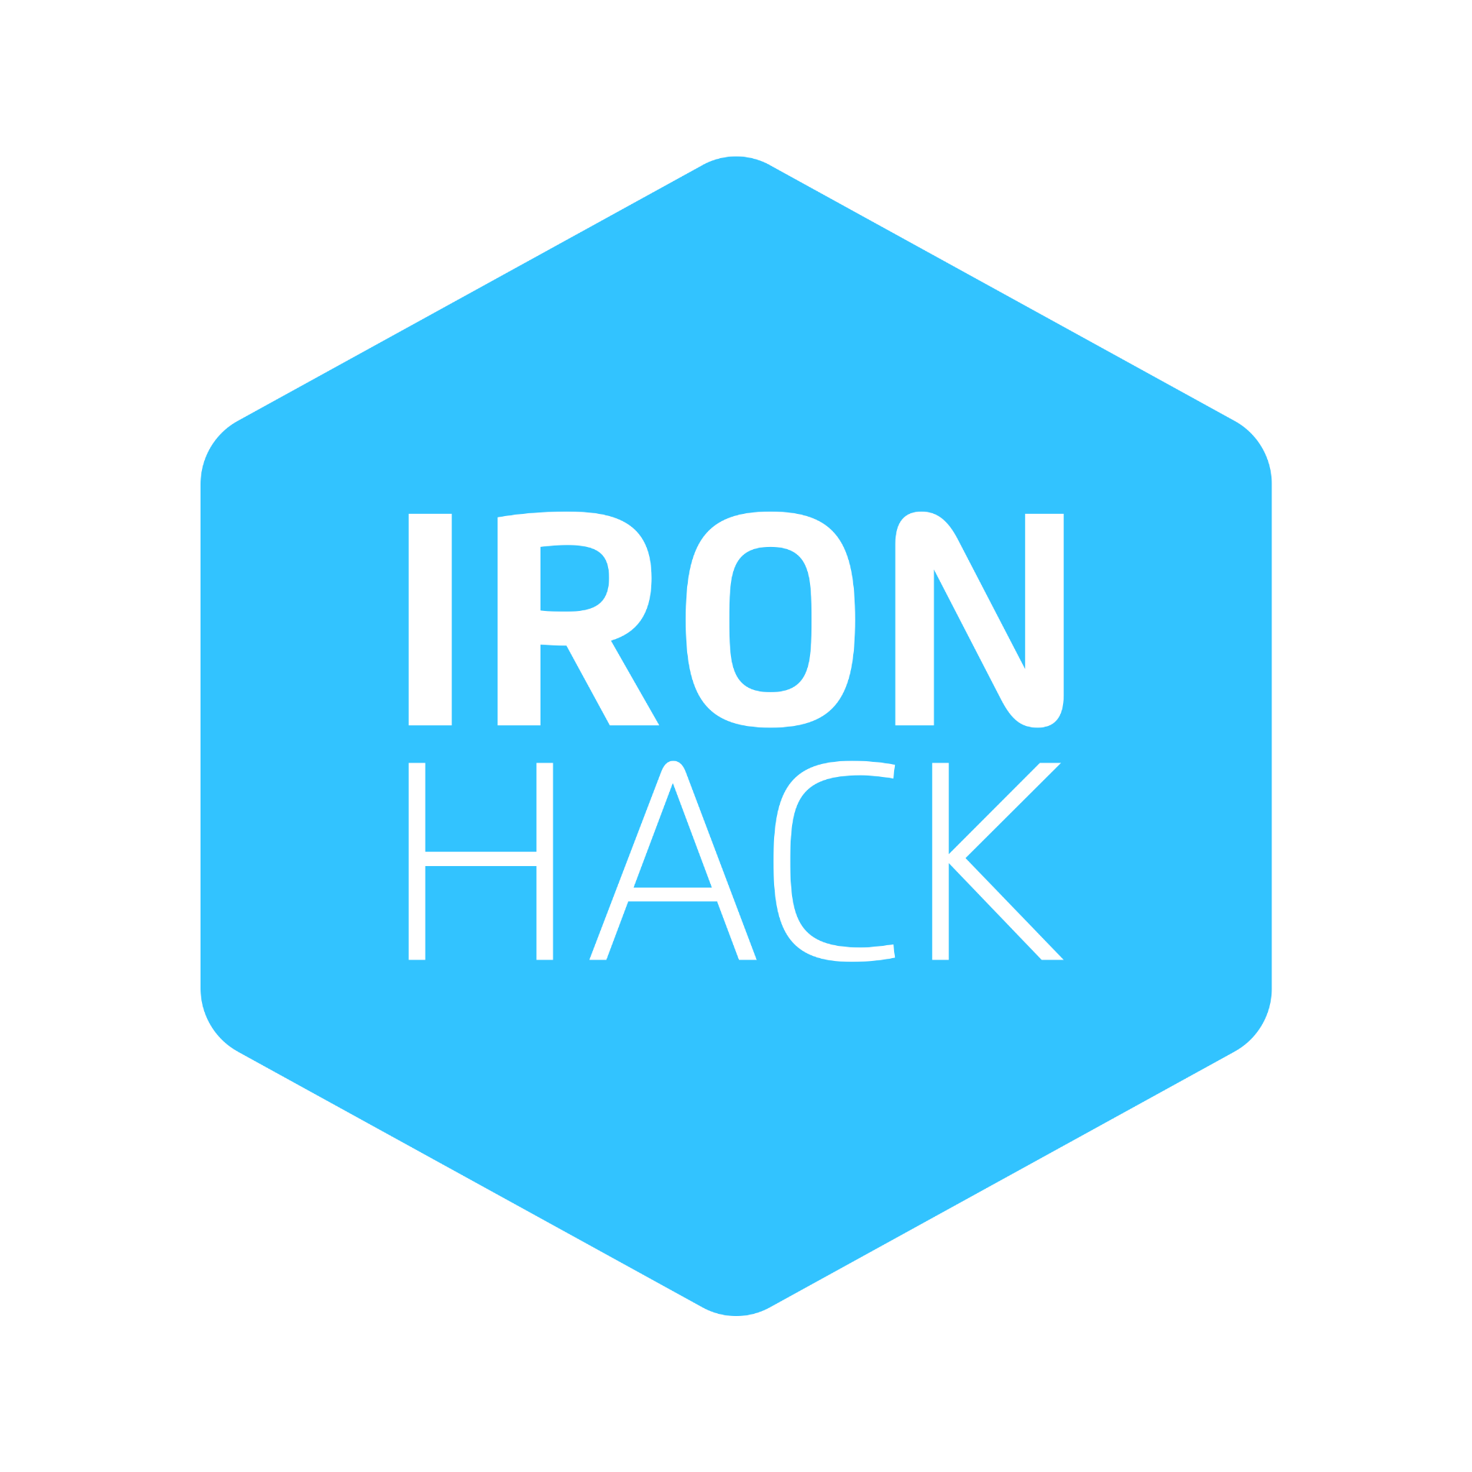
Link Guardian
SECURE URL SAFETY CHECKER made by InfraSquad
Every day, people click links without knowing if they are safe. CheckLink helps users quickly check whether a URL looks suspicious. Our goal was bigger than building a website: we delivered it like a real company would—Securely, Automatically, Cost-aware, and Monitored.
Mahammad Mammadov
Mahammad Suleymanli
Ravan Quliyev
Lala Imamhuseynova
https://casp-linkguardian.duckdns.org/
Trusted HTTPS with Let's Encrypt
Notes:
Good morning, everyone. We're here to talk about CheckLink, our secure URL safety checker. Every day, people click links without knowing if they're safe, and CheckLink helps them quickly assess that risk. But our ambition was bigger than just building an app; we wanted to deliver it like a real company would, focusing on security, automation, cost-awareness, and monitoring. This approach ensures CheckLink isn't just functional, but also robust and trustworthy. Let's dive into the problem we're solving.

Slide 2





A Simple Link Can Create a Big Risk
User Risk
Hard to know if a link is safe before clicking.
Business Risk
Phishing can damage trust and cause critical incidents.
Engineering Risk
A working app is not enough if deployment is insecure.
The problem is not only unsafe links. It lies under unreliable software delivery.
Notes:
So, a simple link can create a big risk, and it's a multi-faceted problem. For users, it's hard to know if a link is safe before clicking, exposing them to phishing and malware. For businesses, phishing attacks can severely damage trust and lead to costly incidents. And from an engineering perspective, a working application isn't enough if its deployment is insecure and unreliable. The real issue isn't just unsafe links; it's also about unsafe and unreliable software delivery. But we've engineered a solution that addresses these risks head-on.

Slide 3










Why DevOps Matters
TRADITIONAL APPROACH
DEVOPS APPROACH
Automated delivery
Manual deployment
Private infrastructure
Public exposure
Monitoring and alerts
No monitoring
Repeatable deployment
Hard to repeat
From "it works on my machine" to "it works reliably for real users."
Notes:
This brings us to why DevOps matters so much for a project like CheckLink. It transforms software delivery, making it faster, safer, cheaper to operate, and easier to improve. We moved from a traditional approach of manual deployments and public exposure to an automated delivery system with private infrastructure, comprehensive monitoring, and repeatable deployments. This shift means we've gone from 'it works on my machine' to 'it works reliably for real users.' Now, let's look at how we built this secure system.

Slide 4

Simple Experience, Serious Engineering
USER FLOW
CLOUD ENGINEERING
Security
WAF v2 + Private VNet
1
Paste suspicious URL
2
Automation
Terraform + Ansible
Instant pattern analysis
3
Clear safety feedback
Monitoring
Azure Monitor + Insights
URL Length
Suspicious Patterns
Typo-squatting
Infrastructure
3-Tier Azure Architecture
Link Format
Notes:
We designed CheckLink for a simple user experience, but it's backed by serious engineering. Users simply paste a URL, we instantly analyze it, and then provide clear safety feedback. Our analysis considers factors like URL length, suspicious patterns, typo-squatting, and link format indicators. Behind this simplicity lies a robust cloud engineering stack, built with security, automation, and monitoring at its core. This blend of user-friendliness and technical rigor is where DevOps truly shines.

Slide 5
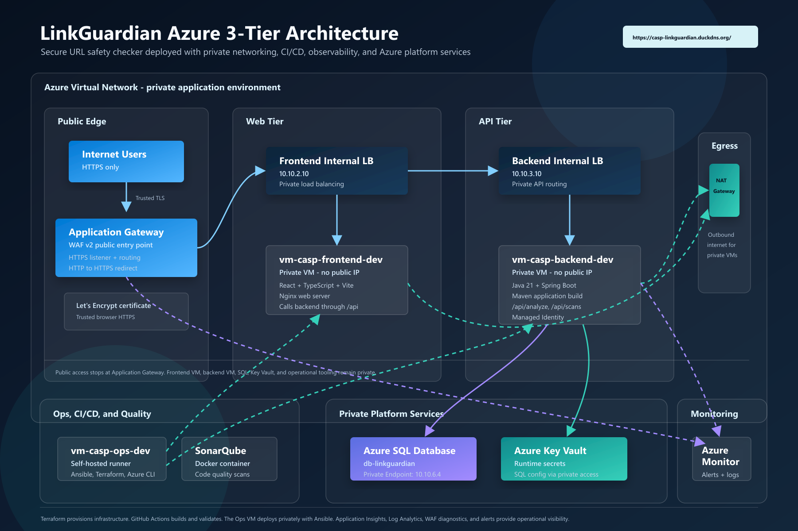





Public App, Private System
SECURE TRAFFIC PATH
User Request
checklink.duckdns.org
Azure WAF v2 (Public Entry)
Internal Load Balancers
Private Frontend & Backend VMs
Private Endpoints
Azure SQL & Key Vault
No public IPs on application VMs
SQL/Vault isolated in private subnets
NAT Gateway for secure outbound only
WAF protects against OWASP Top 10
Notes:
Our architecture for CheckLink is a prime example of a public application with a private system. We ensure only one controlled entry point is public, keeping everything important private and secure. User requests hit our Azure Web Application Firewall, then route through internal load balancers to private virtual machines. Our Azure SQL database and Key Vault are further isolated with private endpoints, meaning no public IPs on our application VMs. This design protects against external threats and ensures our data remains secure. Next, we'll explore how automation underpins this secure delivery.

Slide 6





Faster Delivery, Less Human Error
Terraform
EFFICIENCY
Infrastructure as Code: Provisions the entire Azure environment.
Faster releases with zero manual intervention.
Ansible
RELIABILITY
Configuration Management: Sets up servers and deploys the application.
Predictable deployments across all environments.
CONSISTENCY
GitHub Actions
Eliminates "it works on my machine" syndrome.
CI/CD Orchestration: Builds, tests, and triggers private deployments.
SonarQube
Quality Gate: Automated code analysis and security scanning.
Self-hosted runners ensure deployment happens securely within the private network.
Notes:
We just saw how we keep our system private. Now, let's talk about how we build and deliver CheckLink with speed and precision. Automation is key to faster delivery and significantly reduces human error. We use Terraform for infrastructure, Ansible for configuration, and GitHub Actions for our CI/CD pipeline. This means faster releases, less manual work, and more predictable deployments. Our self-hosted runners ensure secure deployments within our private network. And this automation also lays the groundwork for robust security, which we'll discuss next.

Slide 7




Security: Reducing Risk by Design
Security is built into the architecture, not added at the end.
Edge Protection
Zero-Trust Access
Azure Application Gateway WAF v2 serves as the only public entry point, filtering malicious traffic.
Private Endpoints protect Azure SQL and Key Vault. Secrets are never hardcoded in the application.
Private Infrastructure
Trusted Identity
Virtual machines have no public IPs. All internal communication stays within a private VNet.
End-to-end encryption using trusted Let's Encrypt certificates for a professional deployment model.
Enhanced Trust
Safe Data Access
Production-Grade Security
Notes:
Building on our automated delivery, security isn't an afterthought; it's baked into CheckLink's core architecture. We designed security in from day one, not as an add-on. Our Azure WAF v2 is the only public entry point, filtering malicious traffic before it reaches our system. All our virtual machines have no public IPs, and we use private endpoints for Azure SQL and Key Vault, ensuring zero-trust access. This approach gives us enhanced trust, safer data access, and a truly professional deployment model. But even with the best security, we need to know when things go wrong, which brings us to monitoring.

Slide 8




Finding Problems Before Users Do
OBSERVABILITY STACK
Azure Monitor
Application Insights
Log Analytics
Infrastructure Alerts
CRITICAL METRICS
WAF Health
VM CPU Usage
SQL Utilization
App Errors
Proactive response reduces downtime risk and ensures a seamless user experience.
Notes:
So, we've built a secure and automated system. But how do we know it's actually working as expected? We need to find problems before our users ever do. We use Azure Monitor, Application Insights, and Log Analytics to give us full observability. We track critical metrics like WAF health, VM CPU usage, SQL utilization, and application errors. This proactive response reduces downtime risk and ensures a seamless user experience. And this continuous monitoring also helps us optimize our resources, which is crucial for cost efficiency.

Slide 9








Avoiding Waste in the Cloud
EFFICIENCY STRATEGIES
BUSINESS VALUE
Resource Consolidation
Lower Operational Waste
NAT Gateway centralizes outbound access, eliminating the need for expensive public IPs on every VM.
Paying only for what is needed, when it is needed, through automated resource management.
Lifecycle Automation
Scalable Foundation
Terraform allows resources to be created, scaled, or destroyed cleanly, preventing "zombie" resources.
Internal load balancers prepare for future growth without requiring a costly architectural redesign.
Right-Sizing
Cleaner Operations
Continuous monitoring detects over-provisioned resources, allowing for data-driven scaling decisions.
Standardized infrastructure reduces the hidden costs of manual troubleshooting and environment drift.
"Right resource, right purpose."
Notes:
With our monitoring in place, we can now focus on avoiding waste in the cloud. This isn't just about saving money; it's about smart, sustainable operations. We use a NAT Gateway to centralize outbound access, eliminating the need for expensive public IPs on every VM. Terraform allows us to create, scale, and destroy resources cleanly, preventing 'zombie' resources. And continuous monitoring helps us right-size our resources, ensuring we pay only for what we need. This gives us lower operational waste, a scalable foundation, and cleaner operations overall.

Slide 10




More Than a Demo
Secure
Automated
WAF v2 & Private VNet isolation
Terraform & Ansible delivery
Monitored
Repeatable
Real-time Azure observability
Consistent CI/CD pipelines
Scalable
Trusted
3-Tier architecture foundation
Verified HTTPS certificates
The app works, but more importantly, the system around the app works.
Notes:
We've talked about avoiding waste, and now we're bringing it all together. This isn't just a demo; it's a fully production-ready system. We built CheckLink with security, automation, and monitoring baked in from day one. This means the application isn't just functional; it's robust, reliable, and ready for real-world use. It's a system that works, not just an app that runs. Next, let's look at the team that made this possible.

Slide 11







Four People, One System
Frontend
Backend
Infrastructure
Automation
React + TypeScript + Vite + nginx
Java 21 + Spring Boot
Azure + Terraform
Ansible + GitHub Actions
What Worked Well
Future Improvements
Clear ownership of components
Earlier live demo planning
Fast collaborative troubleshooting
Structured task tracking
Focus on production principles
Advanced security testing
Notes:
Building a system like this takes a focused team, and that's exactly what we had. Our four-person team, each with clear ownership, collaborated seamlessly. This clear division of labor and strong communication led to fast troubleshooting and a shared focus on production principles. We also learned valuable lessons, like the need for earlier demo planning and more structured task tracking, which will make our next project even smoother. Now, let's see this system in action.

Slide 12







Live Proof
Working Web Application
Trusted HTTPS Certificate
GitHub Actions Pipeline
SonarQube Quality Scan
Private Architecture Proof
Monitoring & Alerts
"We did not only deploy LinkGuardian. We built the secure cloud delivery system around it."
SECURE • AUTOMATED • MONITORED
https://casp-linkguardian.duckdns.org/
Notes:
Now for the live proof. We'll demonstrate the working web application, show its trusted HTTPS certificate, and even walk through our GitHub Actions pipeline and SonarQube quality scan. This isn't just about CheckLink; it's about the secure cloud delivery system we built around it. We've created a solution that is secure, automated, and continuously monitored, proving our commitment to robust engineering.

